Slide 1


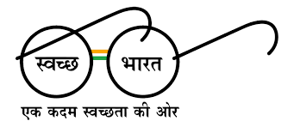



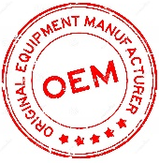



WE MINIMIZE YOUR EFFORTS
MISSION
GREEN INDIA CLEAN INDIA
CONTACT US :
PHUGE INDUSTRIAL HUB, NEAR
MAGZINE CIRCLE, BHOSARI - 411039
MOB.NO.: 8308830595/ 9763419537
EMAIL: info@infinitygrp.co.in
WEBSITE : www.infinitygrp.co.in

Slide 2

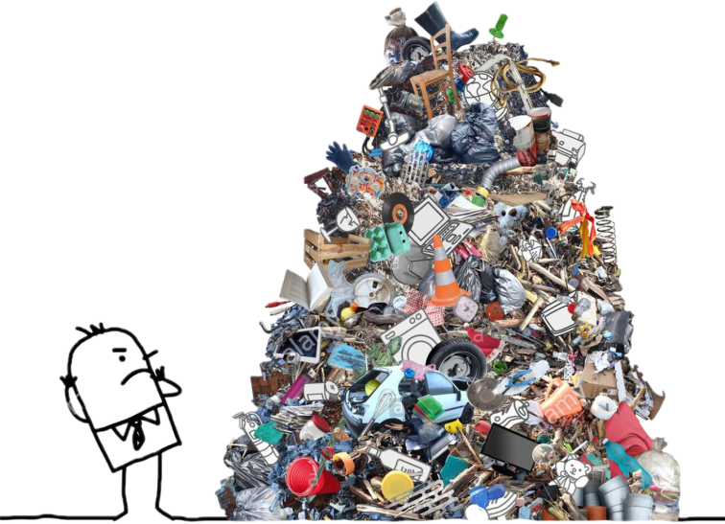

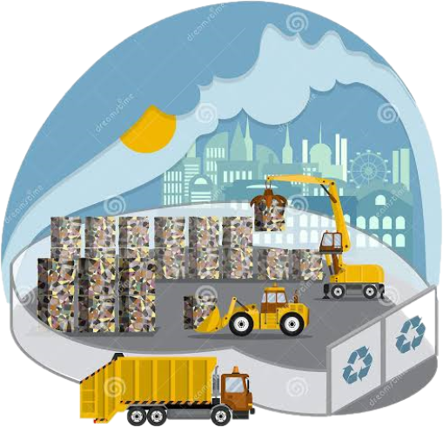


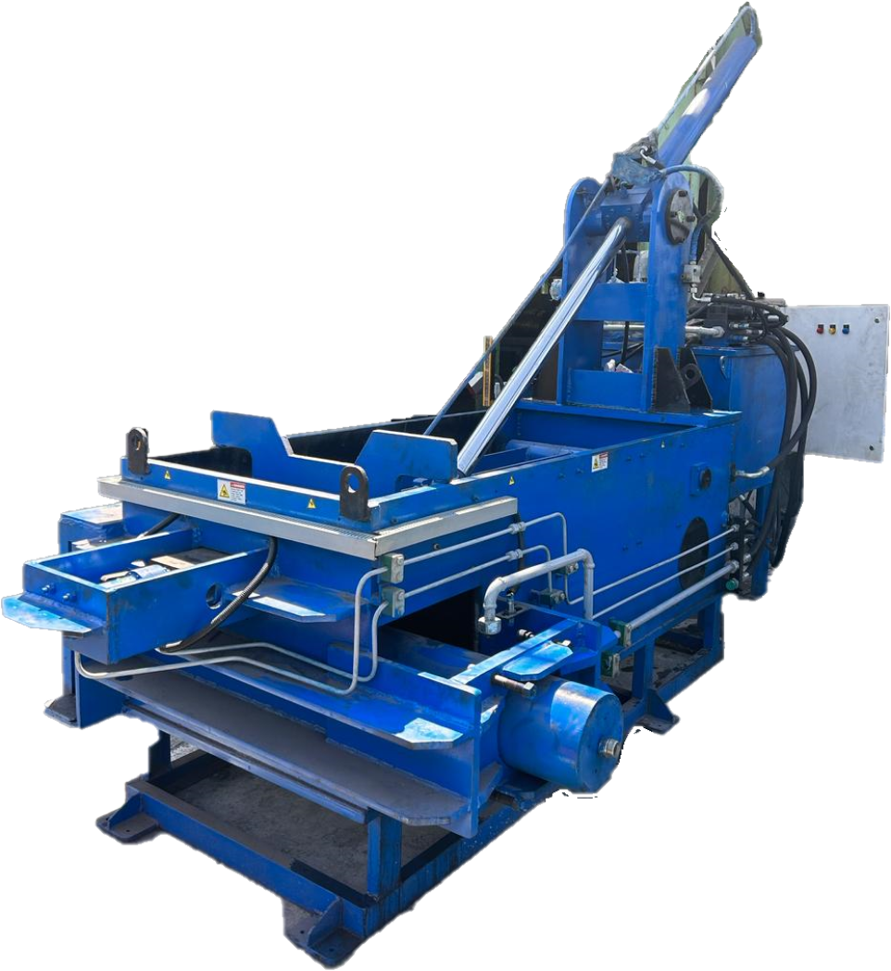
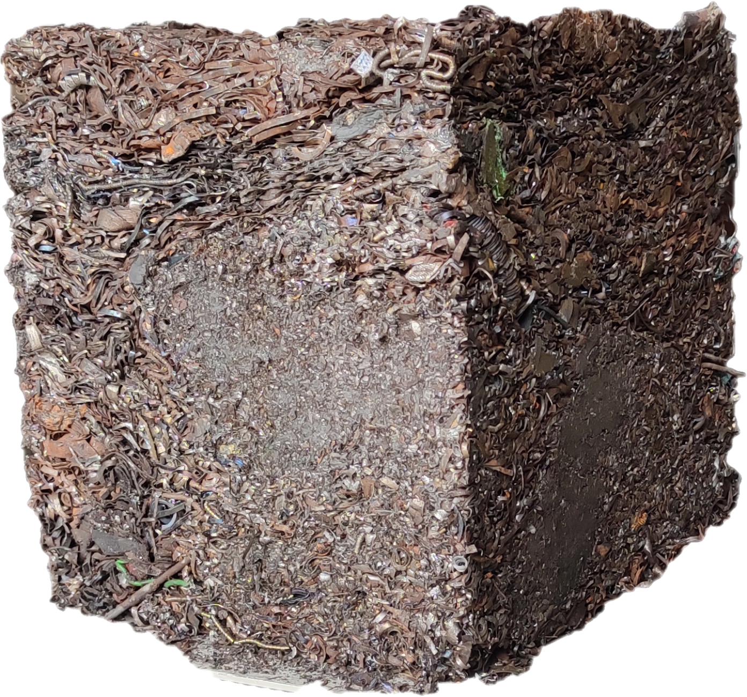
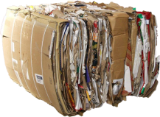
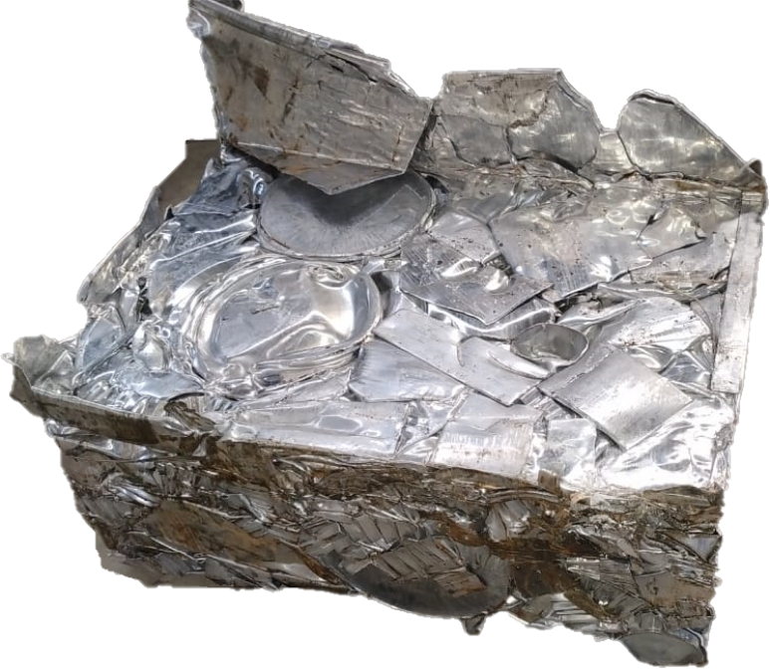
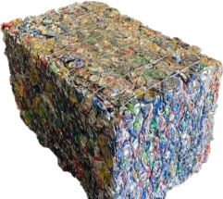
OUR VISION
GROW YOUR BUSUNESS
YOU HAVE A PROBLEM??
THINK INNOVATIVE
REDUCE TRASPORT COST,
SAVE SPACE, EASY HANDLING
COMPACT YOUR WASTE
WE HAVE A SOLUTION!!

Slide 3


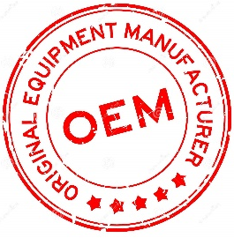
Introduction
INFINITY HYDRAULICS uses only the highest quality products available from industry leaders in every HYDRAULIC PRODUCTS application. We are dedicated to being the industry leader in quality with 100% of all HYDRAULICS PRODUCTS tested to full capacity and specifications every time. By using our modular design, they will look and perform the same every time. At INFINITY HYDRAULICS we will always have a prompt and courteous reply to your inquiries. We’ll never promise something we cannot deliver, with our expansive abilities, and over many years of combined technical experience, rest assured we can deliver what you need. We pride ourselves in carefully listening to our customers, to ensure we understand their wants and needs. Exceptional — that’s what we strive for; we want long-term relationships with all of our customers. Just like our first customer who’s been coming back for 24 years, because we do it RIGHT

Slide 4
Horizontal Baling Machine
Horizontal metal scrap baling machines are used for compressing and compacting metal scrap into dense, manageable bales. This process is crucial for industries involved in metal recycling, manufacturing, and waste management. The primary purposes and applications of horizontal metal scrap baling include:
Recycling and Waste Management
Metal Recycling : Horizontal balers are widely used in metal recycling facilities to compact various types of metal scrap, including ferrous metals (like steel and iron) and non-ferrous metals (like aluminum, copper, and brass). The baling process reduces the volume of scrap, making it easier to transport and process at recycling plants.
Waste Reduction : By compressing metal waste, these balers help in reducing the overall volume of waste, contributing to more efficient waste management practices.
2. Transportation and Storage Efficiency
Reduced Transportation Costs : Compacted bales take up significantly less space than loose scrap, allowing for more efficient loading and transportation. This results in cost savings on shipping and handling.
Optimized Storage : Baled metal scrap occupies less storage space, enabling better utilization of storage facilities and easier inventory management.

Slide 5
3. Preparation for Melting and Refining
Feedstock Preparation : Baled metal scrap is often used as feedstock for smelting and refining processes. The uniform size and density of the bales make them ideal for efficient feeding into furnaces and other processing equipment.
4. Revenue Generation
Selling Scrap : Compacted metal bales are easier to sell to recyclers and scrap metal buyers. The improved density and reduced contamination often result in better market prices for the material.
5. Safety and Handling
Improved Safety : Baling metal scrap reduces the risk of injuries from handling sharp and irregularly shaped materials. Bales are easier and safer to handle compared to loose materials, reducing the risk of injuries from sharp or irregularly shaped items.
6. Industrial Applications
Manufacturing and Production : In manufacturing environments, horizontal balers are used to manage and recycle scrap metal generated during production processes. This can include offcuts, shavings, Turning and defective products.
Automotive and Aerospace Industries : These industries often produce large quantities of metal scrap, such as from vehicle dismantling, repairs, and production. Baling helps in efficiently managing and recycling this scrap.

Slide 6
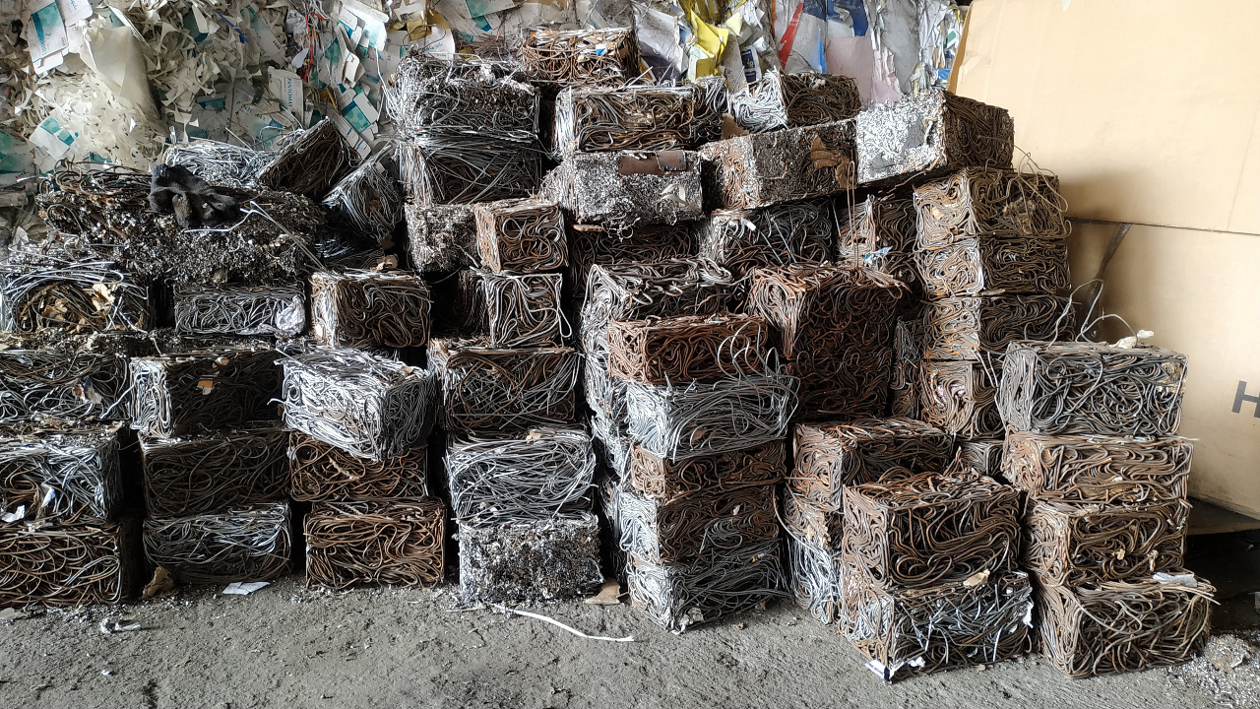
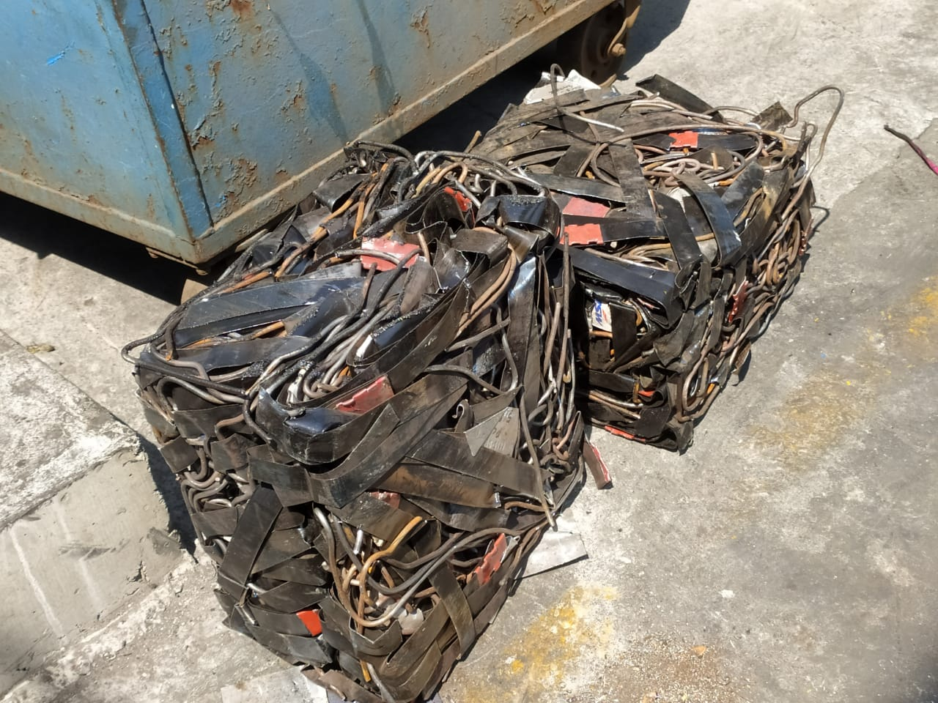
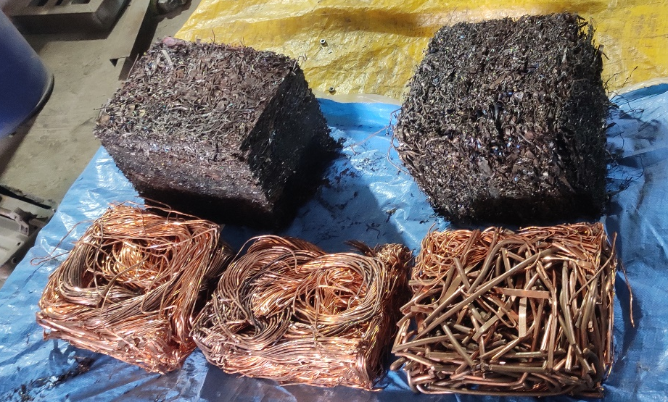
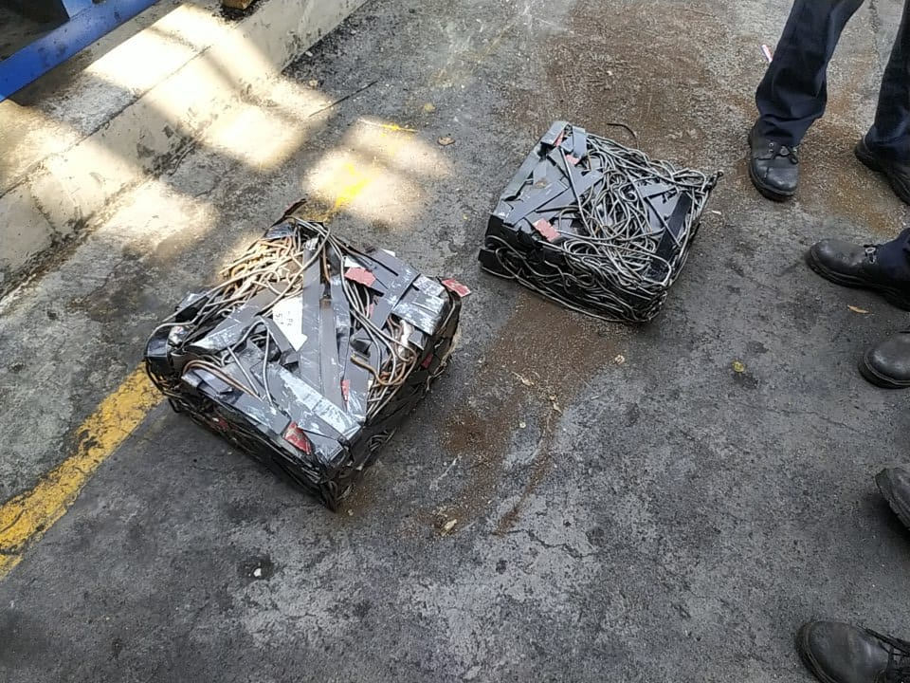
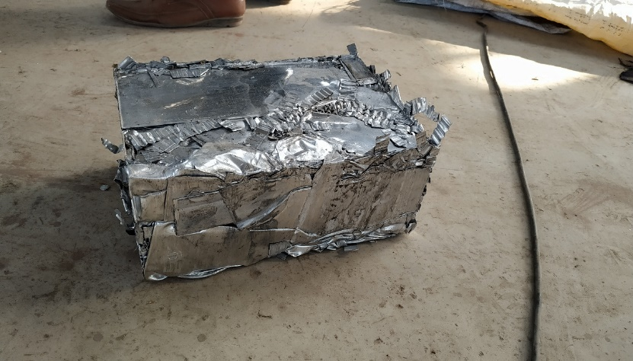
METAL SCRAP BALES

Slide 7








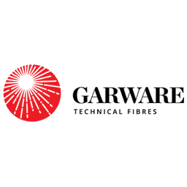


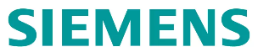
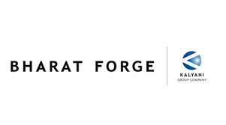








OUR CLIENTS
HERE SOME OUR VALUABLE COUSTOMERS
AND MORE THAN 550’S OF HAPPIEST AND SATISFIED CUSTOMER

